Slide 1
VOICE CONTROLLED HOME AUTOMATION SYSTEM
Project group number : 9
Course name and code : 22AIE114

Slide 2
TEAM MEMBERS
SINDUKURI TEJA – AM.EN.U4AIE22049
M.SANTHOSH KUMAR – AM.EN.U4AIE22033
PATURI SRI RAM – AM.EN.U4AIE22040
V.HEMANTH KUMAR –AM.EN.U4AIE22053

Slide 3
INTRODUCTION
The concept of Home Automation is gaining popularity as it helps in reducing human effort and errors and thus increasing the efficiency. With the help of Home Automation system, we can control different appliances like lights, fans, TV, AC etc.., Additionally ,a home automation system can also provide other features like security, alarms, emergency systems etc. can be integrated
The concept of Home Automation is gaining popularity as it helps in reducing human effort and errors and thus increasing the efficiency. With the help of Home Automation system, we can control different appliances like lights, fans, TV, AC etc.., Additionally ,a home automation system can also provide other features like security, alarms, emergency systems etc. can be integrated

Slide 4
PROBLEM STATEMENT
Clearly state the problem or challenge the project aims to address.
Provide relevant data or statistics to support it.
The goal of this project is to create a model that will be able to recognize and determine the human voice and operate devices according to the instructions given by the person .
Though the goal is to create a model which can act with a bluetooth module, it can be extended by using wifi module too .
The major goal of the proposed system is understanding human language and making the device act according to the instructions given by the person

Slide 5
SDG ADDRESSED
Mention the SDG and how it is related.

Slide 6
LITERATURE REVIEW
Include the papers used to refer for developing the methodology.
. BLUETOOTH BASED HOME AUTOMATION: • In Bluetooth based home automation systems the home appliances are connected to the Arduino BT board at input output ports using relay.
• The program of the Arduino BT board is based on the high level interactive C language of microcontrollers.
• The connection is made via Bluetooth. The password protection is provided so only authorized users are allowed to access the appliances.
• The Bluetooth connection is established between Arduino BT board and phone for wireless communication.
• In this system the python script is used and it can install on any of the Symbian OS environments, it is portable.
• One circuit is designed and implemented for receiving the feedback from the phone, which indicates the status of the device.

Slide 7
METHODOLOGY
Explain the approach or methodology used to tackle the problem.
Highlight key steps or processes involved in the project.

Slide 8
COMPONENTS REQUIRED
Include the main components with estimated price.
1.Arduino UNO
2.Relay
3.Bluetooth Module(HC-05)
4.Android Device

Slide 9
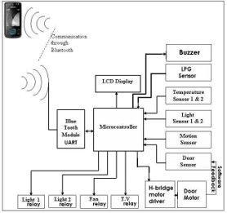
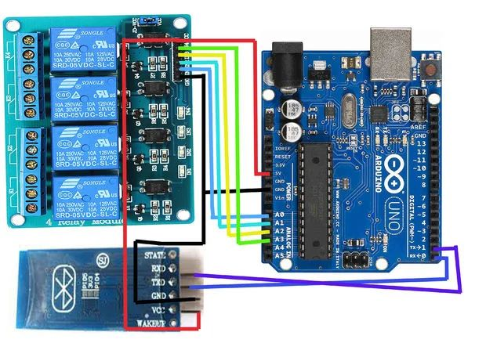
PROPOSED MODEL
The circuit diagram or required flow chart for implementation the project.

Slide 10
TIMELINE
Mention the processes involved in the completion of the project.

Slide 11
WORK COMPLETED

Slide 12
SIMULATION/ HARDWARE
The project system contains 3 main Hardware elements that is smart phone, Arduino Uno board and Bluetooth module. Smartphone is employed to speak with Arduino board employing a smartphone application and Bluetooth Technology. During this analysis work Bluetooth module HC 06 and Arduino Uno used for hardware implementation. A. Arduino Uno Arduino Uno is microcontroller based open source hardware board in which ATmega328P microprocessor used. Here 14 pins are used as digital input or output and 6 pins uses as analog inputs which controls the switches or sensors and control multiple outputs and it operates on 5 to 9 volts DC supply and at 16 MHz quartz frequency clock . It has 32 KB flash memory, 2 Kb SRAM and 1 KB EEPROM.
B. Bluetooth Module HC-06 This device is employed for connection of Arduino Uno and smartphones. HC-06 could be a slave device and it will operates at 3 to 6 volts DC supply. It has 6 pins that is : State, RXD, TXD, GND, VCC and EN. For the communication of the Arduino and the Bluetooth device the RXD pin of HC 06 is connected to the Arduino TXD at pin 1 and the TXD of HC 06 connect to the RXD of the Arduino at pin 0.
C. Relay The proper operation of the project requires an efficient, reliable and fast acting which basically consist of the relays and microcontroller devices. Relay is an electromagnetic device that is use to distinguish two different circuits electrically and connect the magnetically. usually for the interface of the relays electronic circuits associate with it that works on low voltages that works to trigger the devices at high voltages. for an example, a relay will use the 5V DC supply to trigger the 230V AC mains circuit or also higher voltages. A relay switch is operate through an armature which is attracted to an electromagnet or through plunger drawn into the solenoid and this is the input part of the relay that generate force when a low voltage applied to that .This voltage is termed as operative voltage. There are different sizes and configuration of the relays available in market according to operating voltage they are of 5V, 12V, 24V etc. The output section there are 3 terminal present (normally open (NO), normally closed (NC) and common point (COM) that connects or disconnect automatically and it consists of contact switch. once the operating voltage is applied in the relay coil it gets energized and therefore the COM changes contact to NO from NC. There are different relay configurations are in the market like SPST (single pole single throw), SPDT (single pole double throw) and DPDT (double pole double throw) that have completely different range of transmutation contacts. By mistreatment correct combination of contactors, the electric circuit is switched on and off

Slide 13
RESULTS
The main aim of this paper was to propose the solution for the problem concerned with security purposes in the home automation basically related to software change and that is related to the Arduino IDE software that we use in this project that is necessary for the check for the connected user is recognized one or not to enhance the security purposes.

Slide 14
CONCLUSION
In this paper, the architecture of low cost and flexible home Automation system using Arduino microcontroller based on the bluetooth wireless system is proposed and implemented. We use Arduino because this is easy to understand & its coding is very easy. By implementing this type of system we can also ensure the energy conservation that is waste every day in the huge homes and bungalows. By help of this system we can increase the efficiency of the appliances and also we can have the complete control over the home appliances from a long distance. This will Increase the comfortability of human being and it will reduce the Human efforts. The Proposed system is analyzed and tested several times within the range of 20 meters and it achieved 100% accuracy.

Slide 15
REFERENCES
[1]. Amar Pawar, Rahul Sharan , Rahul Patil, and Sandip Chavan , Home Automation using Bluetooth and IOT, International Journal of Innovative Research in Computer and Communication Engineering, Vol. 6, Issue 2, February2018
[2]. Mummaka Sai Srinath1 , Manepalli Nanda Kishore And M.D. Anto Praveena, Interactive Home Automation System With Google Assistant, International Journal of Pure and Applied Mathematics, Volume 119 No. 12 2018, 14083-14086
[3]. Muhammad Asadullah , Smart Home Automation System Using Bluetooth Technology, (ICIEECT), 978-1-5090-3310-2/ 17/$3\.00 ©2017
[4]. J. Kavitha1, O. Naveen, P. Manoj Kumar, K. Subba Rao, Bluetooth Based Home Automation Using Arduino And Android Application, International Journal For Research In Applied Science & Engineering Technology (Ijraset) Issn: 2321-9653; Ic Value: 45.98; Sj Impact Factor: 6.887 Volume 6 Issue Iii, March 2018
[5]. Aayush Agarwal, Anshul Sharma, Asim Saket Samad, S Babeetha, Home Automation System Using Google Assistant, Vol-4 Issue-2 2018 Ijariie-Issn(O)-2395- 4396
[6]. Manish Prakash Gupta, Google Assistant Controlled Home Automation, International Research Journal of Engineering and Technology (IRJET) e-ISSN: 2395- 0056 Volume: 05 Issue: 05 | May-2018
[7]. M. Young, The Technical Writer’s Handbook. Mill Valley, CA: University Science, 1989. [8]. Ramu M,Home Automation System Using IR Sensors. Internation Journal of Electrical and Electronics Engineering, Google scholar, 2015, 4, 11- 16.

Slide 16
THANK YOU

